Slide 1
Employee Data Analysis using Excel
STUDENT NAME: M.sangeetha
REGISTER NO:22IS144
DEPARTMENT:B.Com INFORMATION SYSTEM MANAGEMENT
COLLEGE: DRBCCC HINDU COLLEGE

Slide 2
PROJECT TITLE
Making Charts and Bar diagrams
using Excel

Slide 3


AGENDA
Problem Statement
Project Overview
End Users
Our Solution and Proposition
Dataset Description
Modelling Approach
Results and Discussion
Conclusion
3/21/2024 Annual Review

Slide 4

PROBLEM STATEMENT
Accurate data representation is crucial for effective decision-making and communication. Current methods of visualizing data may be inconsistent or unclear, leading to misinterpretation and reduced insight. The challenge is to develop clear, accurate, and visually appealing charts and bar diagrams that enhance data comprehension and support better business decisions.

Slide 5

PROJECT OVERVIEW
Create clear, informative charts and bar diagrams to visualize data effectively. This involves data collection, designing visualizations using tools like Excel or Tableau, and refining them for accuracy and clarity. The outcome is improved data presentation for better decision-making and communication.

Slide 6

WHO ARE THE END USERS?
Business Analysts
Managers and Executives
Sales and Marketing Teams
Financial Analysts
Researchers and Academics
Stakeholders and Investors

Slide 7

OUR SOLUTION AND ITS VALUE PROPOSITION
Solution: Develop a user-friendly data visualization toolkit that simplifies the creation of accurate and aesthetically pleasing charts and bar diagrams.
Value Proposition: This toolkit enhances data clarity and insight by providing intuitive design options and customization features, enabling users to easily generate effective visualizations that support informed decision-making and clear communication.

Slide 8
Dataset Description
Dataset: Edunet Foundation Dashboard
Features: 34
Features used: 4
Count of Marital Status: text
Count of Education Field: text
Count of Over Time: numbers
Count of Job Role: text

Slide 9

THE "WOW" IN OUR SOLUTION
Our solution stands out with its intuitive design interface and advanced customization features, enabling users to create stunning, accurate charts and bar diagrams effortlessly. With real-time data integration and interactive elements, it transforms complex data into visually compelling insights that captivate and inform stakeholders.
3/21/2024 Annual Review
9

Slide 10
MODELLING
Data Preparation
Data Cleaning
Data Transformation
Chart and Diagram Types:
Bar Charts
Column Charts
Stacked Bar Charts
Grouped Bar Charts
Validation and Refinement:
Accuracy Check
Feedback Integration
Tool Selection
Software Options
Customization Features
10

Slide 11
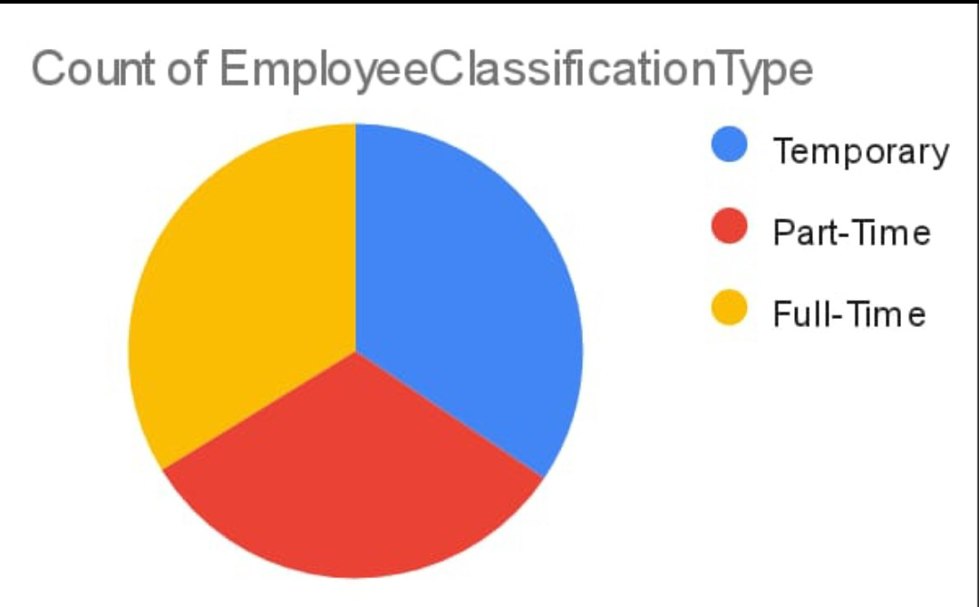
RESULT

Slide 12
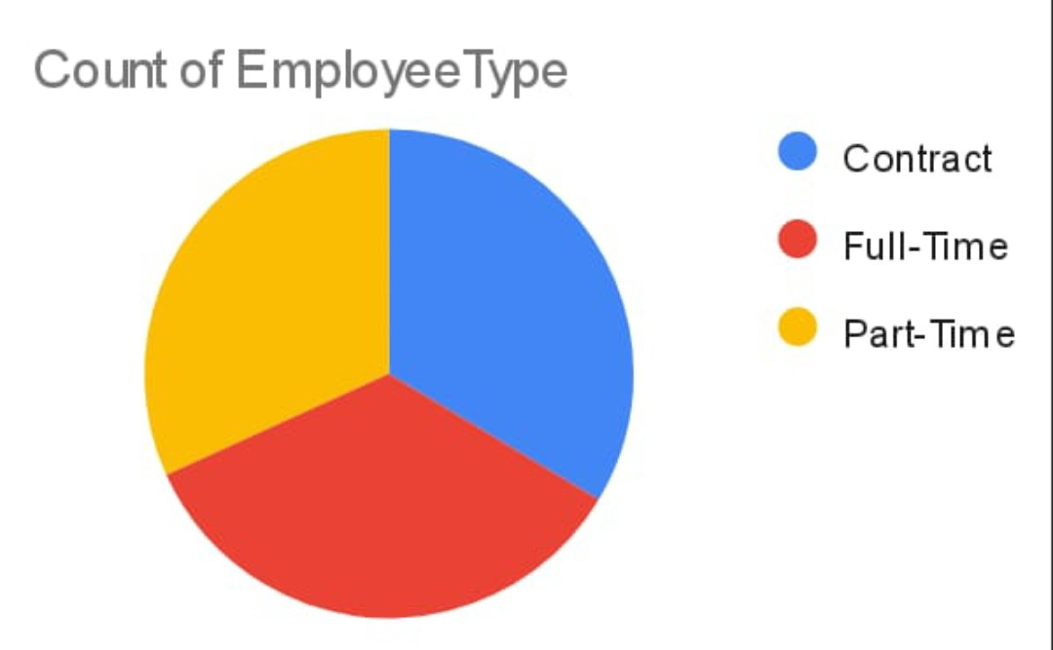
RESULT

Slide 13
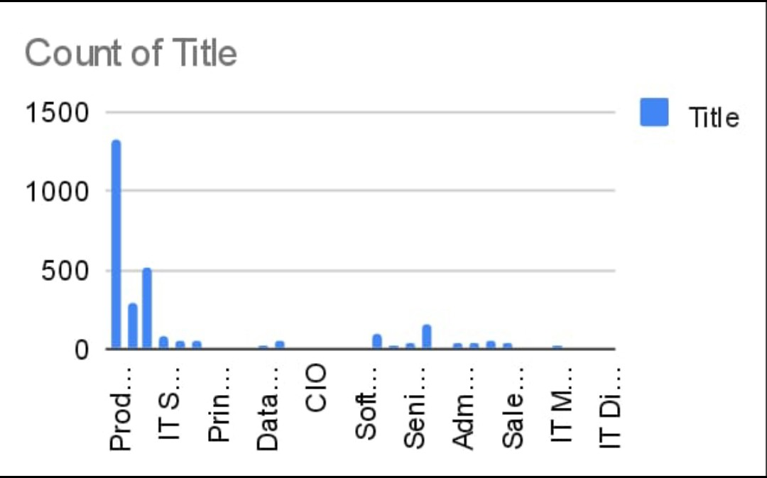
RESULT

Slide 14
conclusion
Effective charts and bar diagrams are crucial for clear data communication and informed decision-making. By preparing data accurately and using intuitive design, these visualizations make complex information accessible and actionable, enhancing understanding and supporting strategic decisions.

